Slide 1
Importing a Biospecimen Management System into REDCap
Bernie LaSalle
Operations Director
Biomedical Research Informatics Service Core
Center for Clinical and Translational Science
Academic Health Sciences Information Technology

Slide 2
Problem Statement
Transforming an MS Access Biospecimen database into a REDCap project
Thousands of biospecimens
Highly relational
Three primary keys that are auto-incremented integers + a character identifier that does not export

Slide 3
Identify Procedures
Schema of existing database
Copies of all data collection forms
Copies of all reports
Meeting with research team
How forms and reports are used
What functionality is critical to maintain
What added functionality is wanted
Feasibility analysis – can this be done?

Slide 4
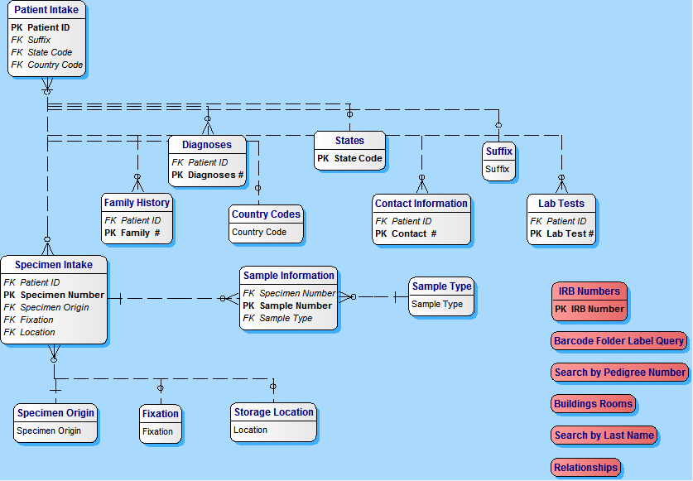
Existing MS Access Database Schema
Reference tables

Slide 5
Issues
One to many (7) relationships
Many to many (1) relationships
Incremental number identifiers - repeat
Study ID P100002 100002
Biospecimen ID SP100002 100002
Sample ID SA100002 100002
Reference tables have to be coded
Each participant can have multiple specimens
Each specimen can become multiple samples

Slide 6
Solutions
Each specimen is an EVENT
There can be up to eight samples per event (specimen)
Samples 2 – 8 are hidden using conditional branching
Incremented identifiers replaced with barcodes
References replaced with codes before import

Slide 7
Process
Create REDCap import table (Rows)
Import first event (specimen 1) data first
Patient Intake
Contact Info
Diagnosis
Family History
Lab Test

Slide 8
Process
Edit specimen data into multiple event files for import
There were several thousand first events
Many hundreds of second events
A few hundred third events
About 100 fourth events
> than 50 fifth events
> 10 sixth events

Slide 9
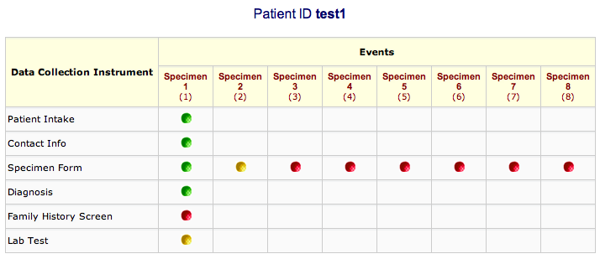

Slide 10
Summary
By following these processes you can
Understand the complexity of the import
Determine if it’s feasible
Estimate the time/effort required
Be confident in your estimates
Give some of the tasks back to the user

Slide 11
Conclusion
Creating an automated/coded solution is not cost effective
Use a standardized process to:
Evaluate the likelihood of success
Model issues
Data issues
Extraction, load and transform process
Import process
Quality assessment

